Slide 1
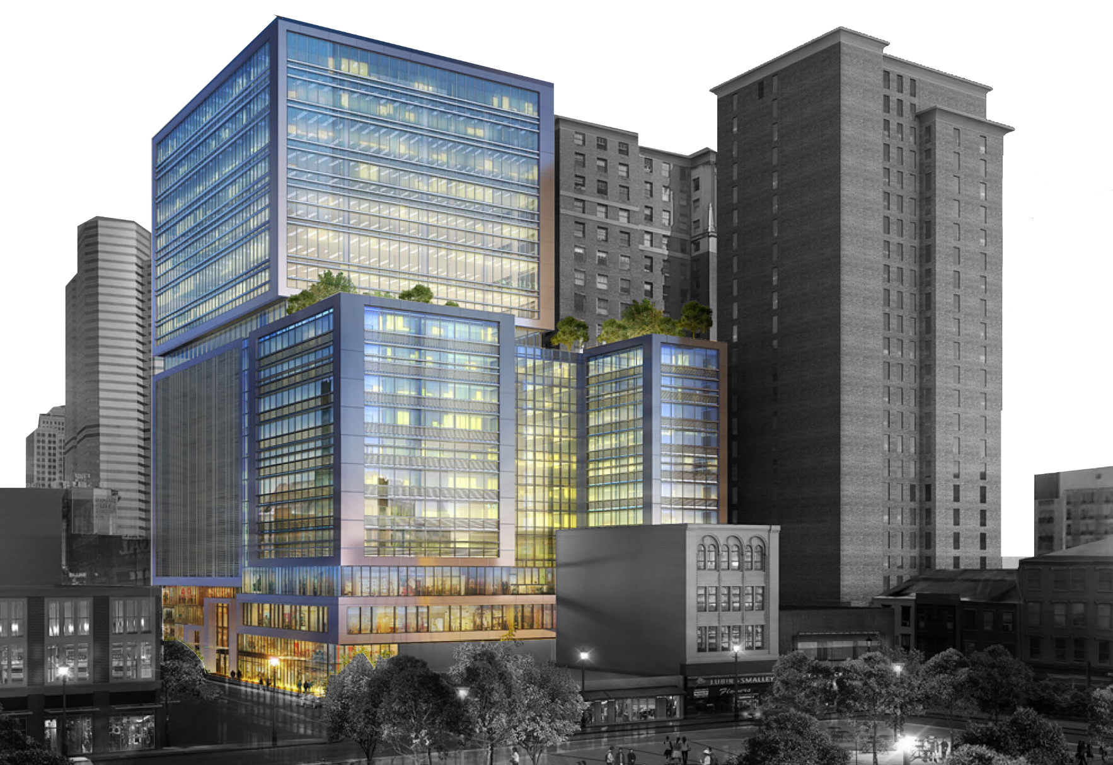
Steel City High-Rise
Pittsburgh, PA
Ashley N. Bistline
Construction Option
Advisor: Somayeh Asadi
Analysis 1:
Steel Fabrication Efficiency
Analysis 2:
Unique Structural Members
Breadths:
Structural and Mechanical
Analysis 3:
Collocation in the Construction Industry
Analysis 4:
Vertical MEP Acceleration

Slide 2
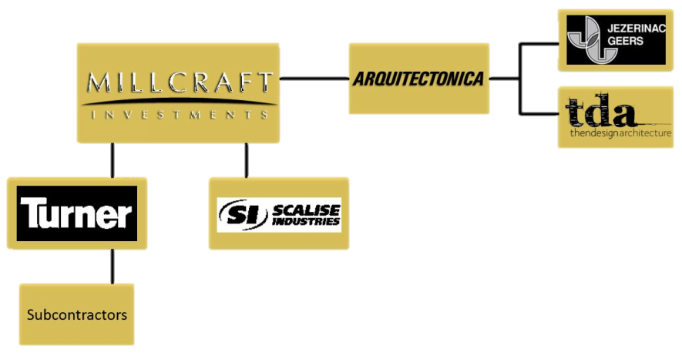
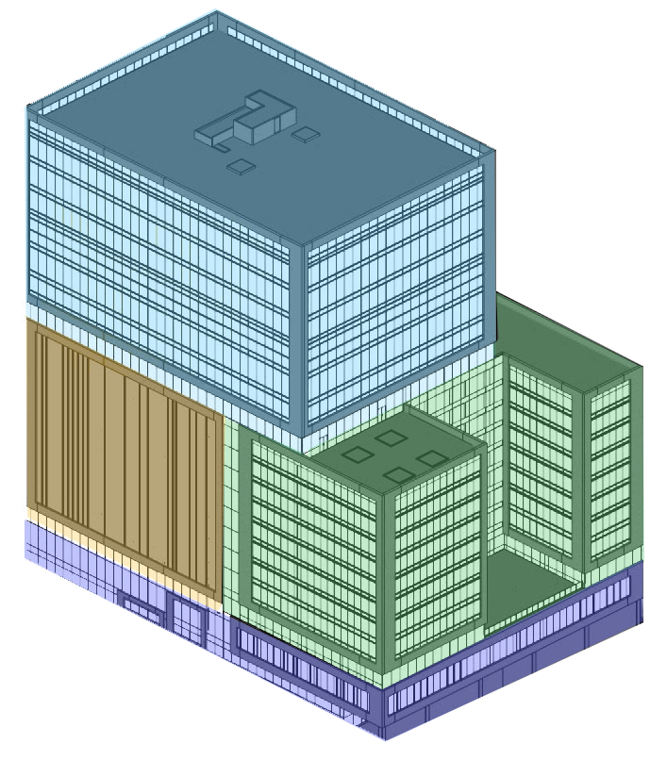
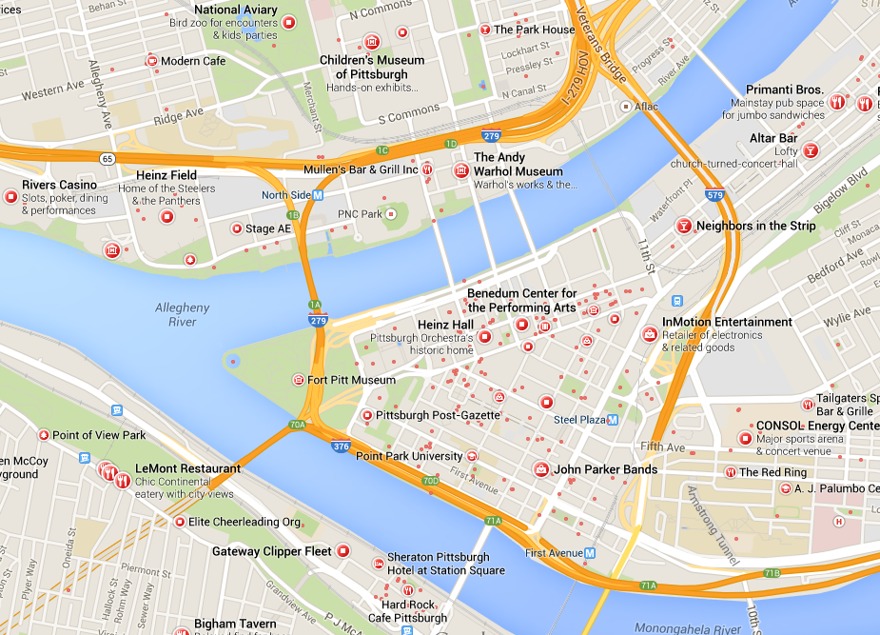

Steel City High-Rise
Presentation Outline
Project Background
Size: 440,000 SF, 18 stories
Building Height: 220 LF
Project Delivery: GMP with CM at Risk
Cost:
          Overall Project: $100,000,000
          Construction: $67,000,000
Construction Dates:
          1/13/14 – 12/10/15
Statistics and Team
Offices
Hotel
Parking Garage
Retail
Occupancy Breakdown

Slide 3
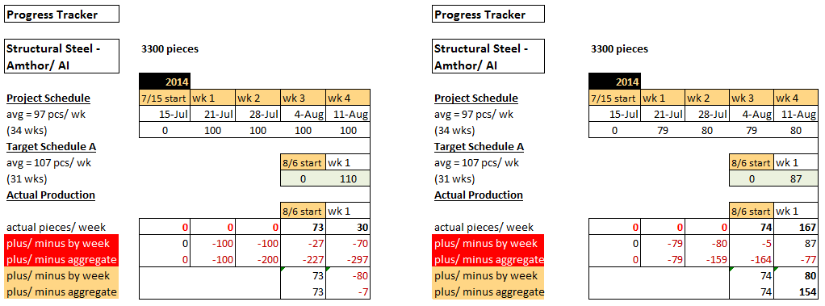
Steel City High-Rise
Presentation Outline
Background
Analysis 1: Steel Fabrication/Efficiency
Project Background
Analysis 1 // Steel Fabrication Efficiency
Background
Fabrication Drivers
Structural Breadth
Mechanical Breadth
Analysis 3 // Collocation in the
Construction Industry
Analysis 4 // Vertical MEP Acceleration
Conclusions and Recommendations
Acknowledgments
Problem and Goals

Slide 4
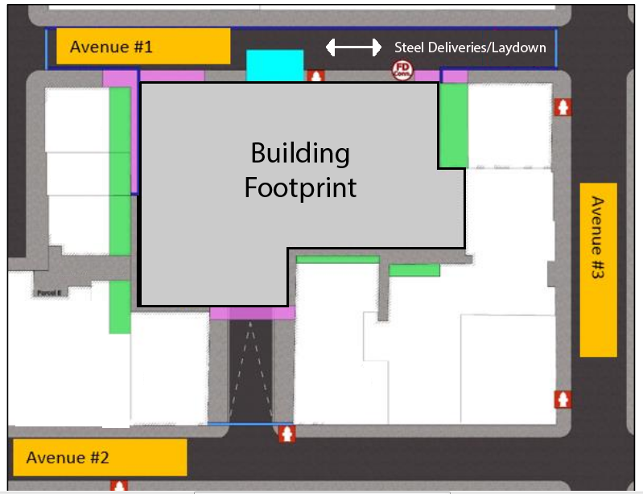
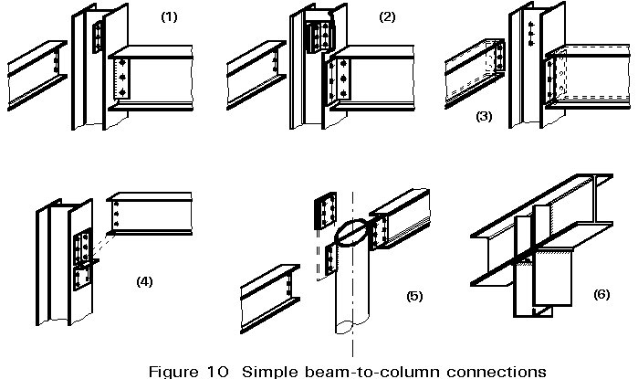
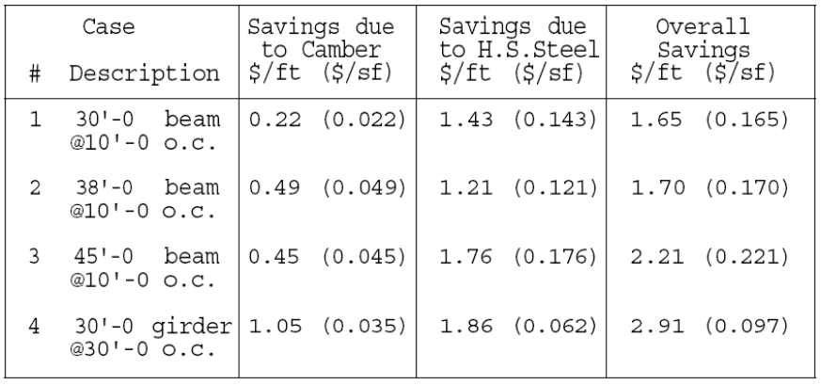
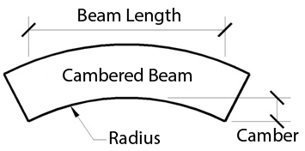
Steel City High-Rise
Presentation Outline
Fabrication Drivers
Analysis 1: Steel Fabrication/Efficiency
Project Background
Analysis 1 // Steel Fabrication Efficiency
Background
Fabrication Drivers
Structural Breadth
Mechanical Breadth
Analysis 3 // Collocation in the
Construction Industry
Analysis 4 // Vertical MEP Acceleration
Conclusions and Recommendations
Acknowledgments
Fabricator Expertise
Notes:
Shear and welds take longer, stout beams, cambered members. Moment connections take the longest to fab because of additional reinforcements
Larson and Huzzard (CE’s): shoring, ponding, upsizing members
Longer fab saves the structure in the long run
Next: sequencing and space for sequence

Slide 5
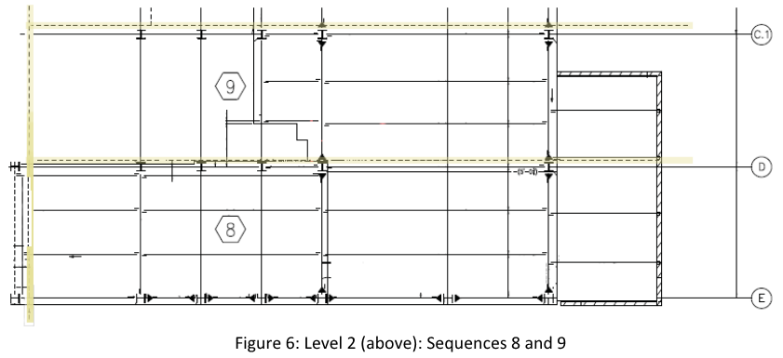
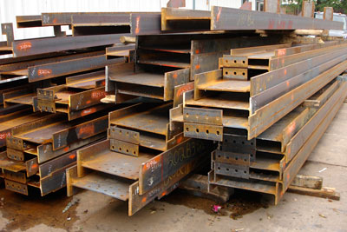
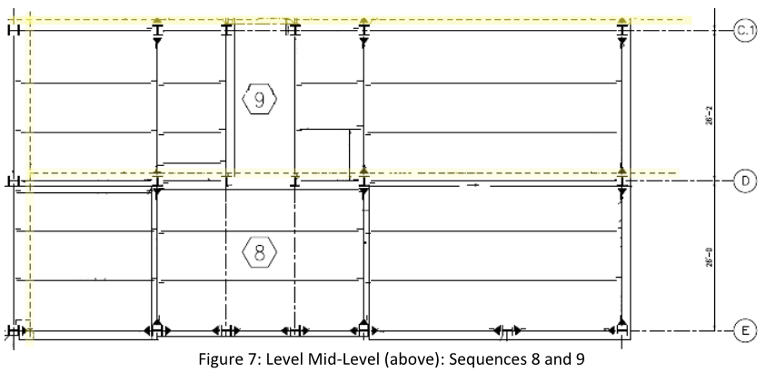
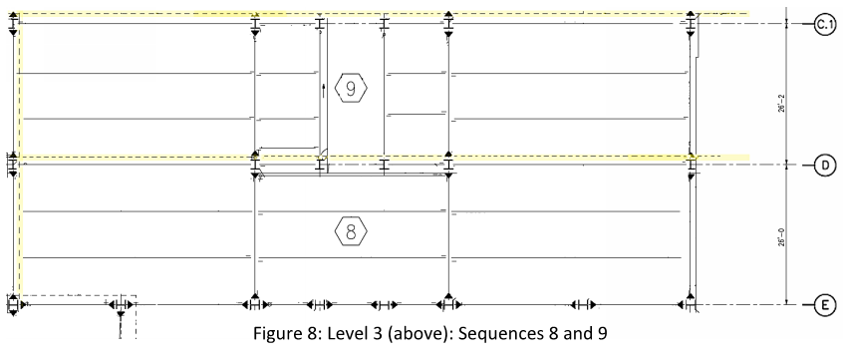
Steel City High-Rise
Presentation Outline
Fabrication Drivers
Analysis 1: Steel Fabrication/Efficiency
Project Background
Analysis 1 // Steel Fabrication Efficiency
Background
Fabrication Drivers
Structural Breadth
Mechanical Breadth
Analysis 3 // Collocation in the
Construction Industry
Analysis 4 // Vertical MEP Acceleration
Conclusions and Recommendations
Acknowledgments
Sequencing and Erection

Slide 6
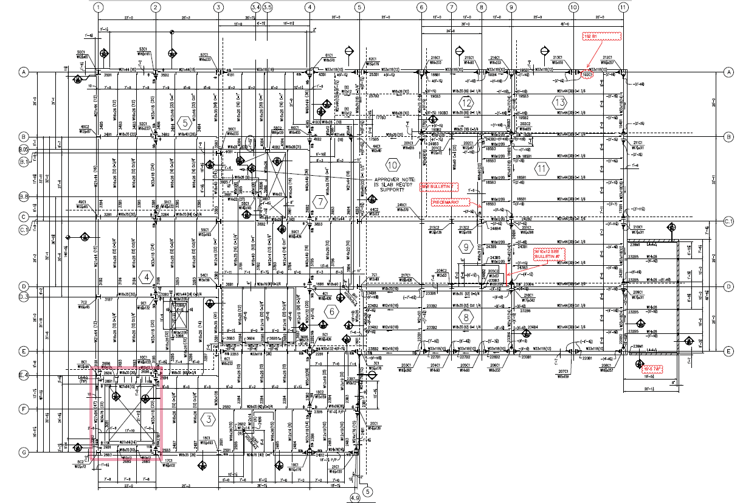
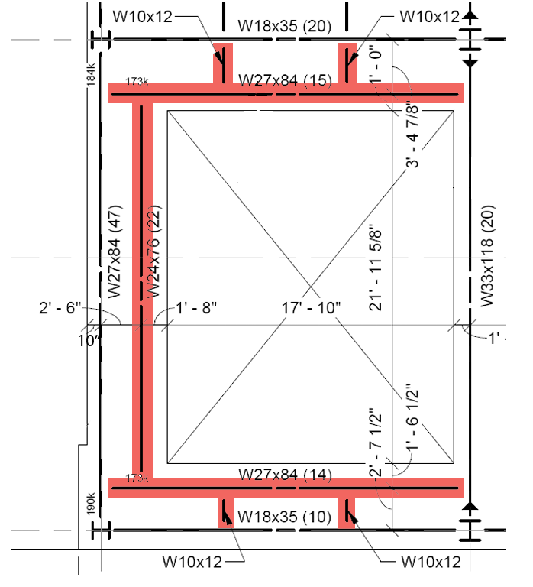
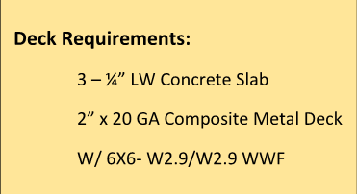
Steel City High-Rise
Presentation Outline
Structural Breadth
Analysis 1 and 2: Fabrication/Unique Structure
Project Background
Analysis 1 // Steel Fabrication Efficiency
Background
Fabrication Drivers
Structural Breadth
Mechanical Breadth
Analysis 3 // Collocation in the
Construction Industry
Analysis 4 // Vertical MEP Acceleration
Conclusions and Recommendations
Acknowledgments
Uniqueness vs Uniformity
Notes:
Talk about steel designer decision making process

Slide 7
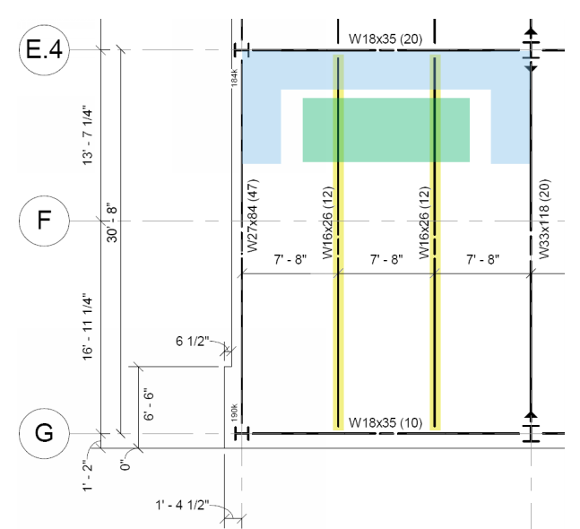
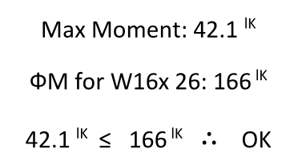
Steel City High-Rise
Presentation Outline
Structural Breadth
Analysis 1 and 2: Fabrication/Unique Structure
Project Background
Analysis 1 // Steel Fabrication Efficiency
Background
Fabrication Drivers
Structural Breadth
Mechanical Breadth
Analysis 3 // Collocation in the
Construction Industry
Analysis 4 // Vertical MEP Acceleration
Conclusions and Recommendations
Acknowledgments
Structural Integrity Checks

Slide 8
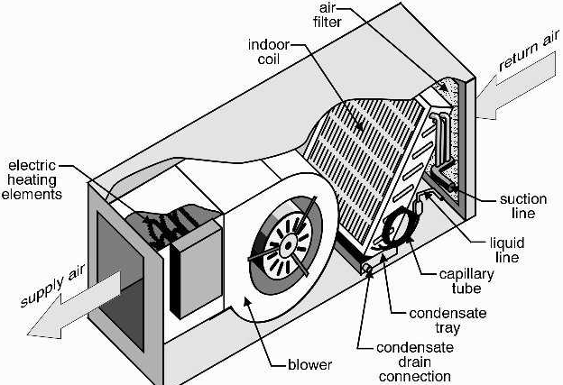
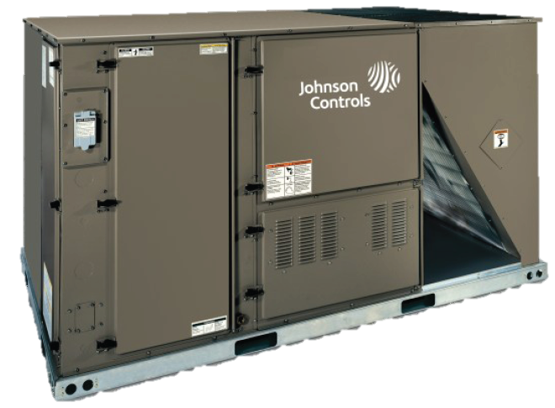
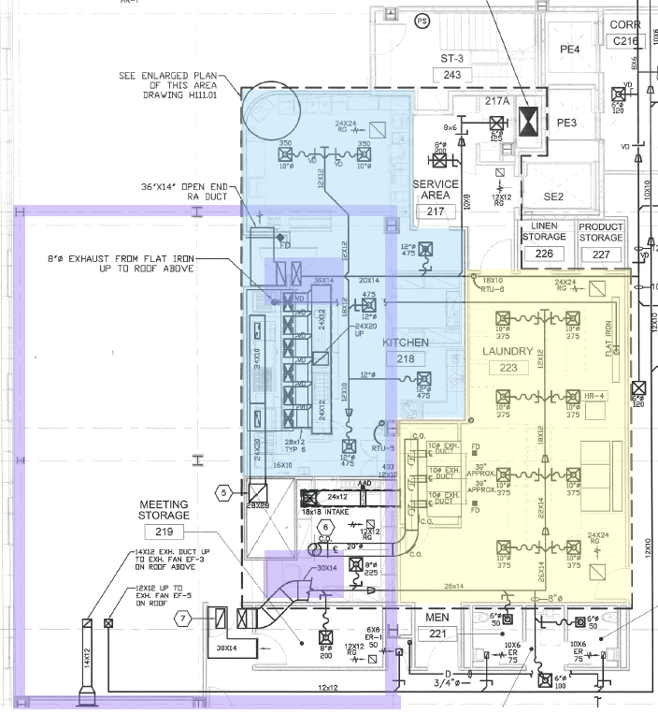
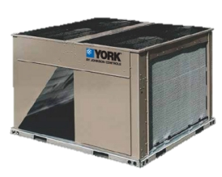
Steel City High-Rise
Presentation Outline
Mechanical Breadth
Analysis 1 and 2: Fabrication/Unique Structure
Project Background
Analysis 1 // Steel Fabrication Efficiency
Background
Fabrication Drivers
Structural Breadth
Mechanical Breadth
Analysis 3 // Collocation in the
Construction Industry
Analysis 4 // Vertical MEP Acceleration
Conclusions and Recommendations
Acknowledgments
Air Handling Reconfiguration
RTU Package Includes:
Condenser/Refrigerant Cooling
Gas Heating
3 HP

Slide 9
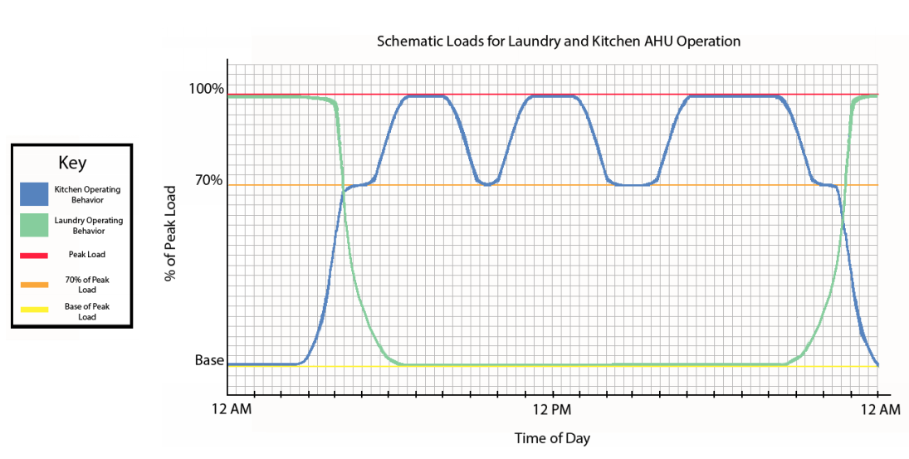
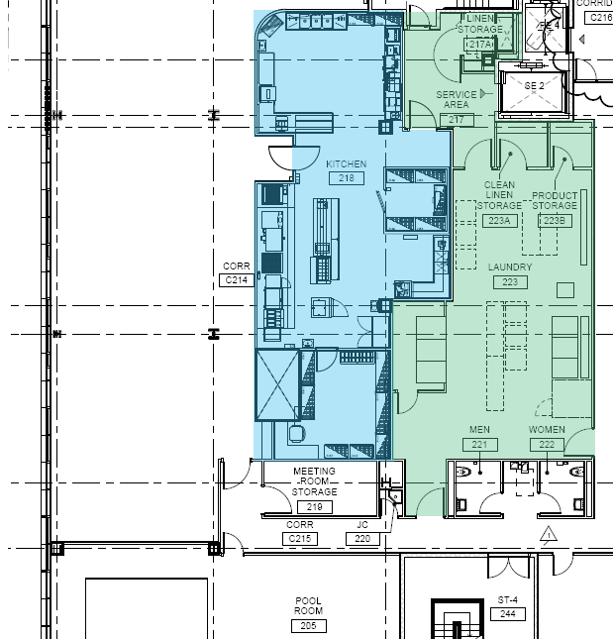

Steel City High-Rise
Presentation Outline
Mechanical Breadth
Analysis 1 and 2: Fabrication/Unique Structure
Project Background
Analysis 1 // Steel Fabrication Efficiency
Background
Fabrication Drivers
Structural Breadth
Mechanical Breadth
Analysis 3 // Collocation in the
Construction Industry
Analysis 4 // Vertical MEP Acceleration
Conclusions and Recommendations
Acknowledgments
Rooftop vs Indoor AHU
2 Units vs 1 Unit
Air Handling Reconfiguration

Slide 10
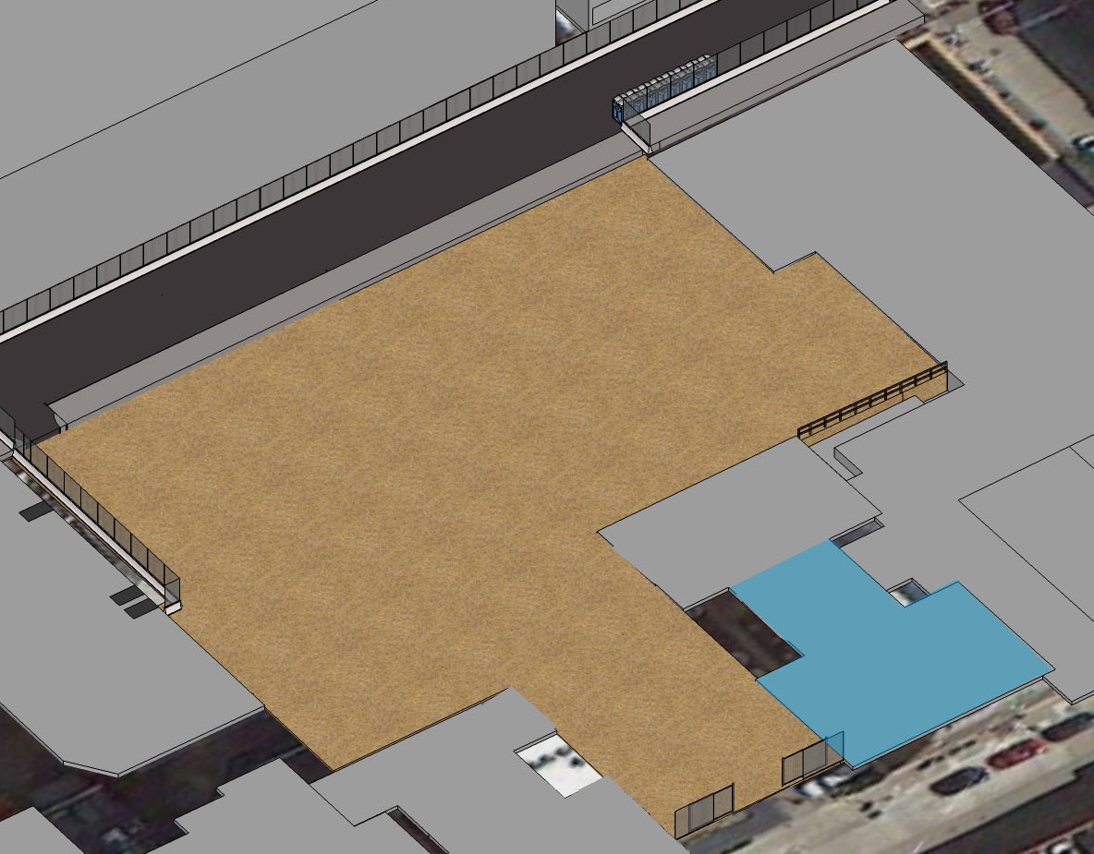
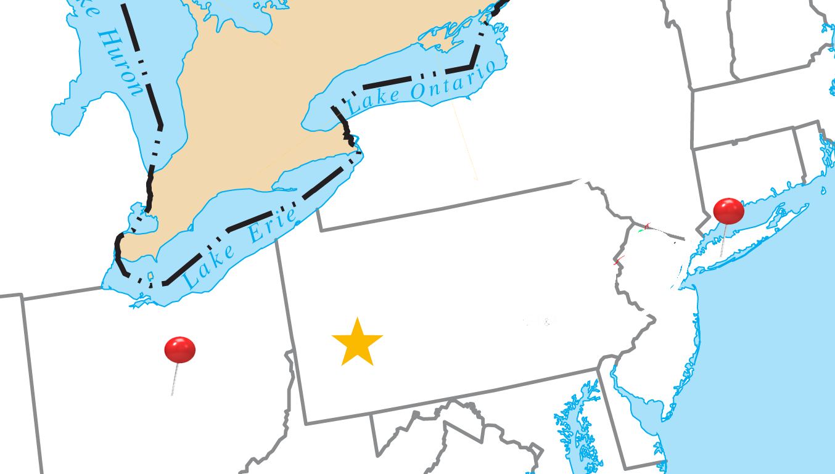
Steel City High-Rise
Presentation Outline
Collocation in Construction
Analysis 3: Collocation in the Construction Industry
Project Background
Analysis 1 // Steel Fabrication Efficiency
Analysis 3 // Collocation in the Construction Industry
At Steel City High-Rise
Participant Diversity
Best Applications
Who Should Participate
Conclusions
Analysis 4 // Vertical MEP Acceleration
Conclusions and Recommendations
Acknowledgments
Collocation at Steel City

Slide 11
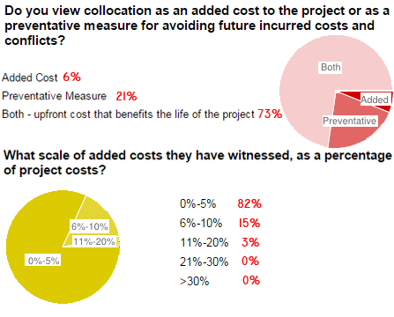
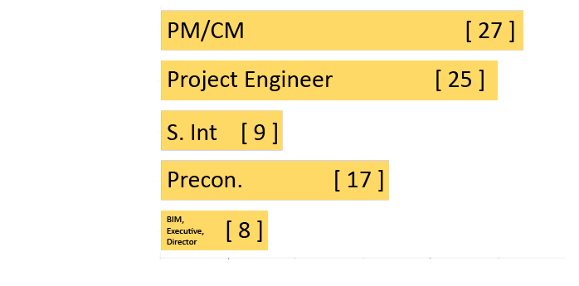
Steel City High-Rise
Presentation Outline
Participant Diversity
Analysis 3: Collocation in the Construction Industry
Participant Experience:
3% : < 1 Year
3%: 1-3 Years
6%: 3-5 Years
18%: 5-10 Years
25%: 10-15 Years
9%: 15-20 Years
36%: 20+ Years
83%
have worked on a collocated project before
Project Background
Analysis 1 // Steel Fabrication Efficiency
Analysis 3 // Collocation in the Construction Industry
At Steel City High-Rise
Participant Diversity
Best Applications
Who Should Participate
Conclusions
Analysis 4 // Vertical MEP Acceleration
Conclusions and Recommendations
Acknowledgments
97%
Collocated Projects
say that working in a collocated space was a positive experience
Notes:
Fix and add roles

Slide 12

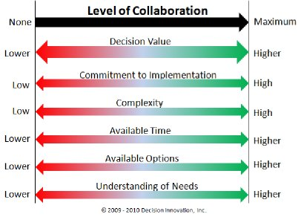

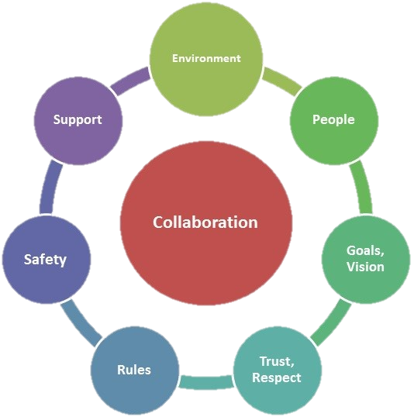
Steel City High-Rise
Presentation Outline
Best Applications
Analysis 3: Collocation in the Construction Industry
Project Background
Analysis 1 // Steel Fabrication Efficiency
Analysis 3 // Collocation in the Construction Industry
At Steel City High-Rise
Participant Diversity
Best Applications
Who Should Participate
Conclusions
Analysis 4 // Vertical MEP Acceleration
Conclusions and Recommendations
Acknowledgments
Collocated Projects

Slide 13
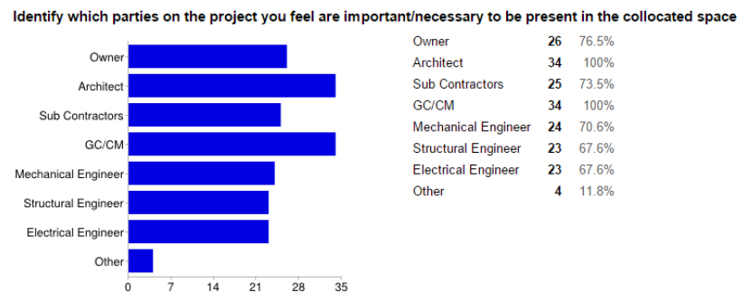
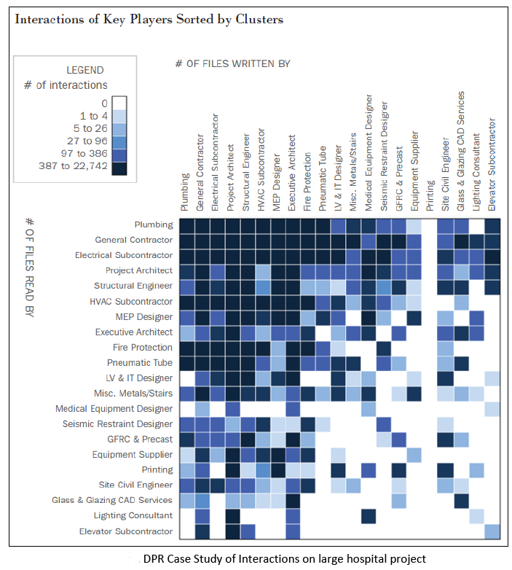
Steel City High-Rise
Presentation Outline
Who Should Participate?
Analysis 3: Collocation in the Construction Industry
Project Background
Analysis 1 // Steel Fabrication Efficiency
Analysis 3 // Collocation in the Construction Industry
At Steel City High-Rise
Participant Diversity
Best Applications
Who Should Participate
Conclusions
Analysis 4 // Vertical MEP Acceleration
Conclusions and Recommendations
Acknowledgments
94%
say that productivity and reliability increase with collocation
Choosing Partakers
71%
Consider:
Risk
Duration
Package Value
Complexity
say that value is lost without full cooperation

Slide 14
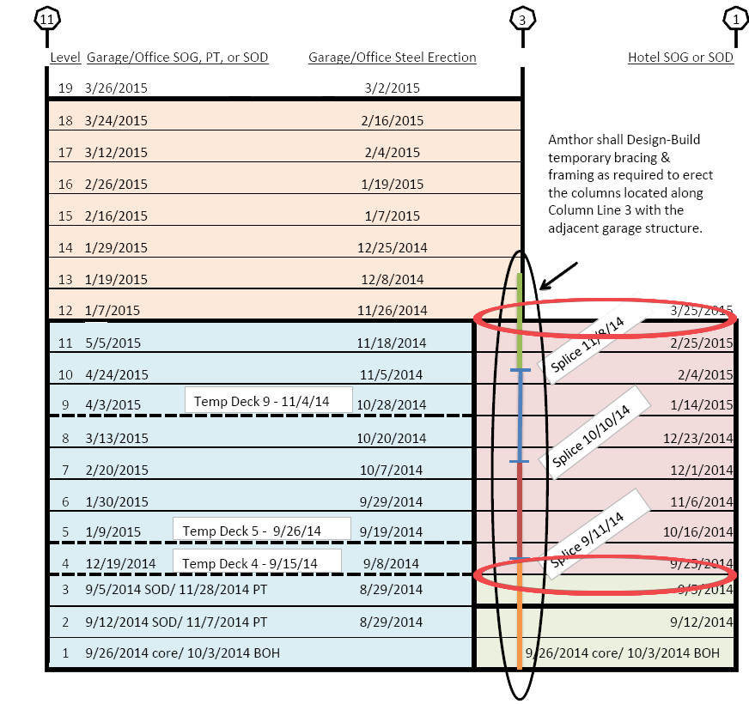
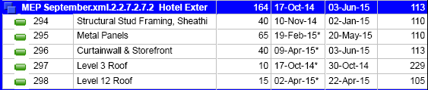
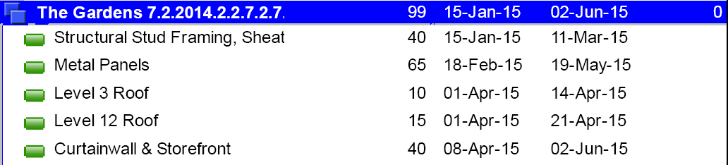
Steel City High-Rise
Presentation Outline
Schedule Comparison
Analysis 4: Vertical MEP
Accelerated Roof:
Project Background
Analysis 1 // Steel Fabrication Efficiency
Analysis 3 // Collocation in the
Construction Industry
Analysis 4 // Vertical MEP Acceleration
Schedule Comparison
Savings
Conclusions and Recommendations
Acknowledgments
Schedule Rework
Original Roof:
Does not impact: crew, durations, or equipment during construction

Slide 15
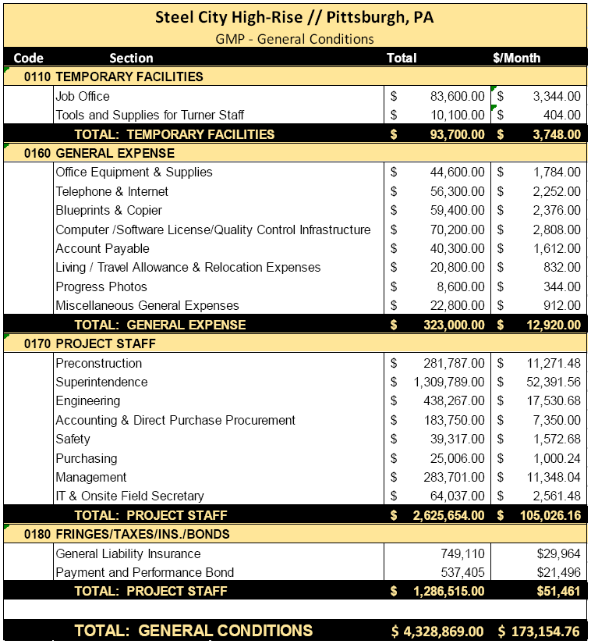
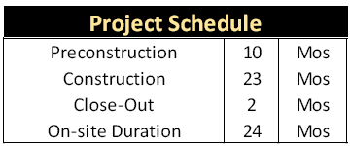
Steel City High-Rise
Presentation Outline
Savings
Analysis 4: Vertical MEP
Project Background
Analysis 1 // Steel Fabrication Efficiency
Analysis 3 // Collocation in the
Construction Industry
Analysis 4 // Vertical MEP Acceleration
Schedule Comparison
Savings
Conclusions and Recommendations
Acknowledgments
Schedule and Cost Impact

Slide 16
Steel City High-Rise
Presentation Outline
Conclusions and Recommendations
Ashley N. Bistline // Construction Management
Recommend
Recommend
Recommend
[[ Analyses 1 & 2 ]] Steel Fabrication/Breadths
More efficient units, prevents short cycling, extends life of units
[[ Analysis 3 ]] Collocation in Construction
Prevents issues/swift conflict resolution, improves communication, establishing long-term relationships, increases innovation
[[ Analysis 4 ]] Vertical MEP Acceleration
Can save the project schedule an additional month and save between $340,000 and $1,020,000.
Project Background
Analysis 1 // Steel Fabrication Efficiency
Analysis 3 // Collocation in the Construction Industry
Analysis 4 // Vertical MEP Acceleration
Conclusions and Recommendations
Acknowledgments

Slide 17
Steel City High-Rise
Presentation Outline
Acknowledgments
Ashley N. Bistline // Construction Management
Academic:
Industry/Professional:
Special Thanks to:
Dr. Somayeh Asadi
Dr. Rob Leicht
Professor Parfitt
Dr. Charles Cox
Professor Jim Faust
Penn State Architectural Engineering Faculty
Turner Construction Company
Millcraft Investments
Amthor Steel
Johnson Controls
PACE Industry Members
Family and Friends
God
AE Power Players
OPP 2015 Captains
AE Class 2015

Slide 18
Steel City High-Rise
Presentation Outline
Ashley N. Bistline // Construction Management
Questions?

Slide 19
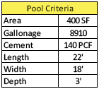

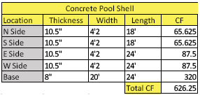
Steel City High-Rise
Presentation Outline
Appendix A: Structural Breadth
Ashley N. Bistline // Construction Management
Weight of Concrete for Pool:
626.25 𝐶𝐹 × (150 𝑙𝑏𝑠/1 𝐶𝐹) = 93,937.5 𝑙𝑏𝑠
Weight of Deck: Area: 28 SF
1.97 𝑃𝑆𝐹 × 28 𝑆𝐹 = 55.16 𝑙𝑏𝑠
Project Background
Analysis 1 // Steel Fabrication Efficiency
Analysis 3 // Collocation in the Construction Industry
Analysis 4 // Vertical MEP Acceleration
Conclusions and Recommendations
Acknowledgments
Weight of Water:
8910 𝐺𝑎𝑙𝑙𝑜𝑛𝑠 × (8.3454 𝑙𝑏𝑠/1 𝐺𝑎𝑙𝑙𝑜𝑛) = 74,357.514 𝑙𝑏𝑠
Weight of Concrete on Deck: Area: 28 SF
28 𝑆𝐹 × 3.25′ = 90.22 𝐶𝐹
90.22 𝐶𝐹 × (115 𝑙𝑏𝑠/𝐶𝐹) = 10,375.5 𝑙𝑏𝑠
Old Design
Weight of Steel Members
(84 𝑙𝑏𝑠/𝐿𝐹) × 23.25′ = 1953 𝑙𝑏𝑠 × 2 𝑏𝑒𝑎𝑚𝑠= 3,906 𝑙𝑏𝑠
(12 𝑙𝑏𝑠/𝐿𝐹) × 2.625′ = 31.5 𝑙𝑏𝑠 × 4 𝑏𝑒𝑎𝑚𝑠= 126 𝑙𝑏𝑠
(76 𝑙𝑏𝑠/𝐿𝐹) × 21.97′ = 1,670 𝑙𝑏𝑠
Total: 5,702 lbs
𝑻𝒐𝒕𝒂𝒍 𝑾𝒆𝒊𝒈𝒉𝒕 𝒐𝒇 𝑷𝒐𝒐𝒍 𝑫𝒆𝒔𝒊𝒈𝒏: 184,428 𝑙𝑏𝑠 = 184.4 𝑘𝑖𝑝𝑠

Slide 20

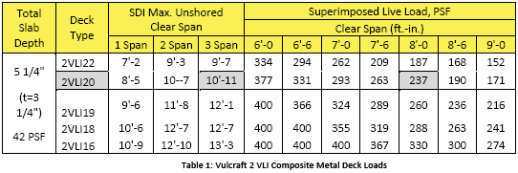
Appendix A: Structural Breadth
Ashley N. Bistline // Construction Management
Weight of 2VLI20 deck:
1.97 𝑃𝑆𝐹 × 714.9375 𝑆𝐹 = 1,408.4269 𝑙𝑏𝑠
Weight of LW Concrete:
115 PCF × (3.25 𝑖𝑛/12 𝑖𝑛) (1 𝑓𝑡) = 31.1458 𝑃𝑆𝐹
31.1458 𝑃𝑆𝐹 × 714.9375 𝑆𝐹 = 22,267.3242 𝑙𝑏𝑠
Project Background
Analysis 1 // Steel Fabrication Efficiency
Analysis 3 // Collocation in the Construction Industry
Analysis 4 // Vertical MEP Acceleration
Conclusions and Recommendations
Acknowledgments
Weight of the W16x26 Beams:
26 ∗ 30.75" = 799.5 𝑙𝑏𝑠
799.5 𝑙𝑏𝑠 × 2 𝑏𝑒𝑎𝑚𝑠 = 1,599 𝑙𝑏𝑠
New Design
Total weight of the slab system:
𝑊𝑡𝑜𝑡 = 𝑊𝑑𝑒𝑐𝑘 + 𝑊𝑐𝑜𝑛𝑐𝑟𝑒𝑡𝑒 + 𝑊𝑏𝑒𝑎𝑚𝑠
= 1,408.4269 𝑙𝑏𝑠 + 22,267.3242 𝑙𝑏𝑠 + 1599 𝑙𝑏𝑠
= 25,274.7511 𝑙𝑏𝑠
= 25.27 𝑘𝑖𝑝𝑠

Slide 21
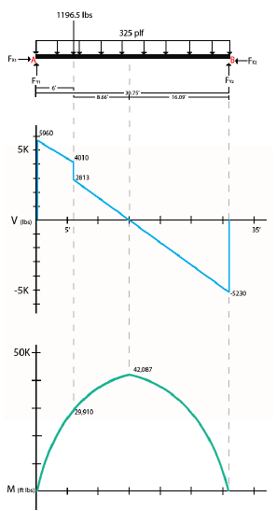
Steel City High-Rise
Presentation Outline
Appendix A: Structural Breadth
Ashley N. Bistline // Construction Management
𝐷𝑖𝑠𝑡𝑟𝑖𝑏𝑢𝑡𝑒𝑑 𝐿𝑜𝑎𝑑:
𝐴𝑇 × 42 𝑃𝑆𝐹 = 7.75′ × 42 = 325 𝑃𝐿𝐹
Project Background
Analysis 1 // Steel Fabrication Efficiency
Analysis 3 // Collocation in the Construction Industry
Analysis 4 // Vertical MEP Acceleration
Conclusions and Recommendations
Acknowledgments
Σ𝐹𝑋 = −𝐹𝑋1 = 𝐹𝑋2
Σ𝐹𝑌 = −1196.5 − (325 𝑃𝐿𝐹 × 30.75′)+ 𝐹𝑌1 + 𝐹𝑌2
Σ𝑀𝐴 = (−1196.5 × 6′)− (9993.75 × 15.375′)+ 𝐹𝑌2(30.75′) = 0
𝐹𝑌2 = 5,230 𝑙𝑏𝑠
𝐹𝑌1 = 5,960 𝑙𝑏𝑠
Loading of AHU
Max Moment: 42.1 lK
ФM for W16x 26: 166 lK
42.1 lK ≤ 166 lK ∴ OK

Slide 22
Steel City High-Rise
Presentation Outline
Appendix B: Mechanical Breadth
Ashley N. Bistline // Construction Management
Converting HP to kW:
𝐻𝑃 ×. 7457 𝑘𝑊/𝐻𝑃
𝑘𝑊 × (8766 ℎ𝑜𝑢𝑟𝑠/𝑦𝑒𝑎𝑟)
𝑘𝑊(ℎ𝑟𝑠) × ($00.0989/𝑘𝑊)
OLD UNITS
Cooling Power Yearly Cost of RTU-5 and RTU-6:
3 𝐻𝑃 ×. 7457 𝑘𝑊/𝐻𝑃= 2.2371 𝑘𝑊
2.2371 𝑘𝑊 × (8766 ℎ𝑜𝑢𝑟𝑠/𝑦𝑒𝑎𝑟)
= 19,610.4186 𝑘𝑊ℎ𝑟𝑠/𝑦𝑒𝑎𝑟
19,610.4186 𝑘𝑊(ℎ𝑟) × ($00.0989/(𝑘𝑊(ℎ𝑟))
= $1,939.47/𝑦𝑒𝑎𝑟 × 2 units
= $3,878.94
NEW UNITS
Cooling Power Yearly Cost of New Indoor AHU:
5 𝐻𝑃 ×. 7457 𝑘𝑊/𝐻𝑃= 3.7285 𝑘𝑊
3.7285 𝑘𝑊 × (8766 ℎ𝑜𝑢𝑟𝑠/𝑦𝑒𝑎𝑟) = 32,684.031 𝑘𝑊ℎ𝑟𝑠/𝑦𝑒𝑎𝑟
32,684.031 𝑘𝑊(ℎ𝑟) × ($00.0989𝑘𝑊(ℎ𝑟))
= $3,232.45/𝑦𝑒𝑎𝑟
Project Background
Analysis 1 // Steel Fabrication Efficiency
Analysis 3 // Collocation in the Construction Industry
Analysis 4 // Vertical MEP Acceleration
Conclusions and Recommendations
Acknowledgments
Schedule and Cost Impact
Annual Savings Comparison:
OLD Cost: $3,878.94
New Cost: $3,232.45
Total Savings: $636.49

Slide 23
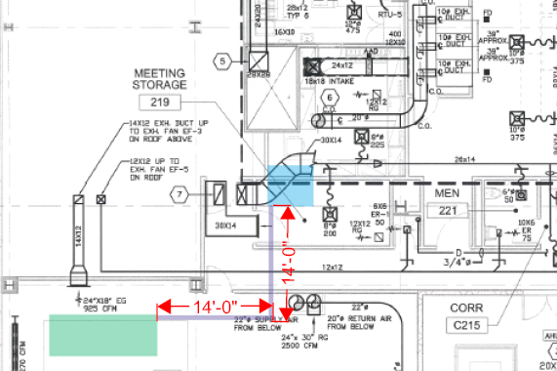
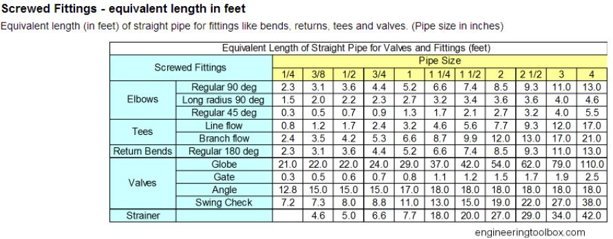
Steel City High-Rise
Presentation Outline
Appendix B: Mechanical Breadth
Ashley N. Bistline // Construction Management
Project Background
Analysis 1 // Steel Fabrication Efficiency
Analysis 3 // Collocation in the Construction Industry
Analysis 4 // Vertical MEP Acceleration
Conclusions and Recommendations
Acknowledgments
Refrigerant Lines

Slide 24
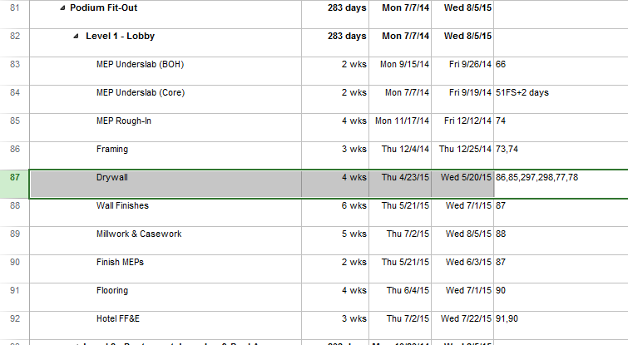
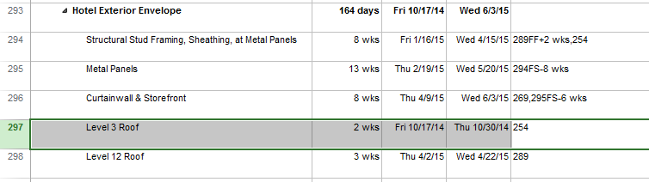
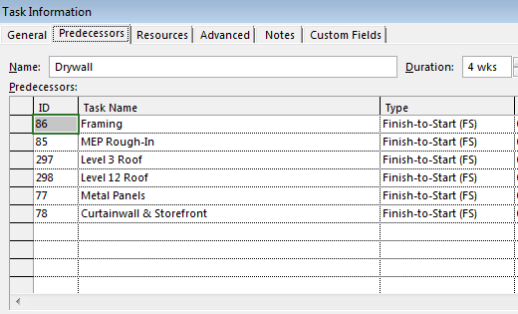
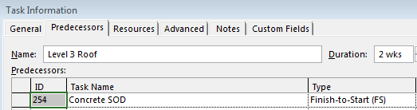
Steel City High-Rise
Presentation Outline
Appendix C: Vertical MEP Logic
Ashley N. Bistline // Construction Management
SOD @ Level 5

